Slide 1

Artificial Intelligence (AI) Course Summary
This presentation provides a comprehensive summary of the key theoretical and practical topics covered in the Artificial Intelligence course.

Slide 2
Theory Part:
Foundational Concepts of AI
What is AI
Goals of AI
Applications of AI
The study of agents that perceive their environment and take actions that maximize their chance of successfully achieving their goals.
To make computers think like humans, act like humans, think rationally, and act rationally.
Includes areas like robotics, natural language processing, expert systems, and machine learning.
Approaches of AI
Turing Test
Focuses on symbolic reasoning, connectionism (neural networks), and statistical methods.
A test of a machine's ability to exhibit intelligent behavior equivalent to, or indistinguishable from, that of a human.

Slide 3

Turing Test
A test of a machine's ability to exhibit intelligent behavior equivalent to, or indistinguishable from, that of a human.

Slide 4





Agents and Learning Components
Agents and their types
Components of a Learning Agent
Simple Reflex
Acts only on the basis of the current percept.
Model-based
Maintains an internal state to track unobserved aspects of the current state.
Goal-based
Uses goal information to decide which actions to take.
Utility-based
Chooses actions that maximize the expected utility.
Learning agent
Can learn from its experiences and improve its performance.
Critic
Tells the learning element how well the agent is doing.
Learning Element
Responsible for making improvements.
Performance Element
Selects external actions.
Problem Generator
Suggests actions that will lead to new, informative experiences.

Slide 5
Environment Types and Rationality
Fully/Partially Observable
Deterministic/Stochastic
Episodic/Sequential
Can the agent sense the complete state of the environment?
Is the next state completely determined by the current state and the agent's action?
Are the agent's actions divided into atomic episodes, or do current decisions affect future ones?
Single/Multi-Agent
Static/Dynamic
Discrete/Continuous
Is there only one agent or are there multiple agents interacting?
Does the environment change while the agent is deliberating?
Are the states and actions finite and distinct, or do they exist on a range?
Known/Unknown
Does the agent know the rules of the environment?
Concept of Rationality: A rational agent is one that does the right thing—every action it takes is expected to maximize its performance measure, given the evidence provided by the percept sequence and whatever built-in knowledge the agent has.

Slide 6
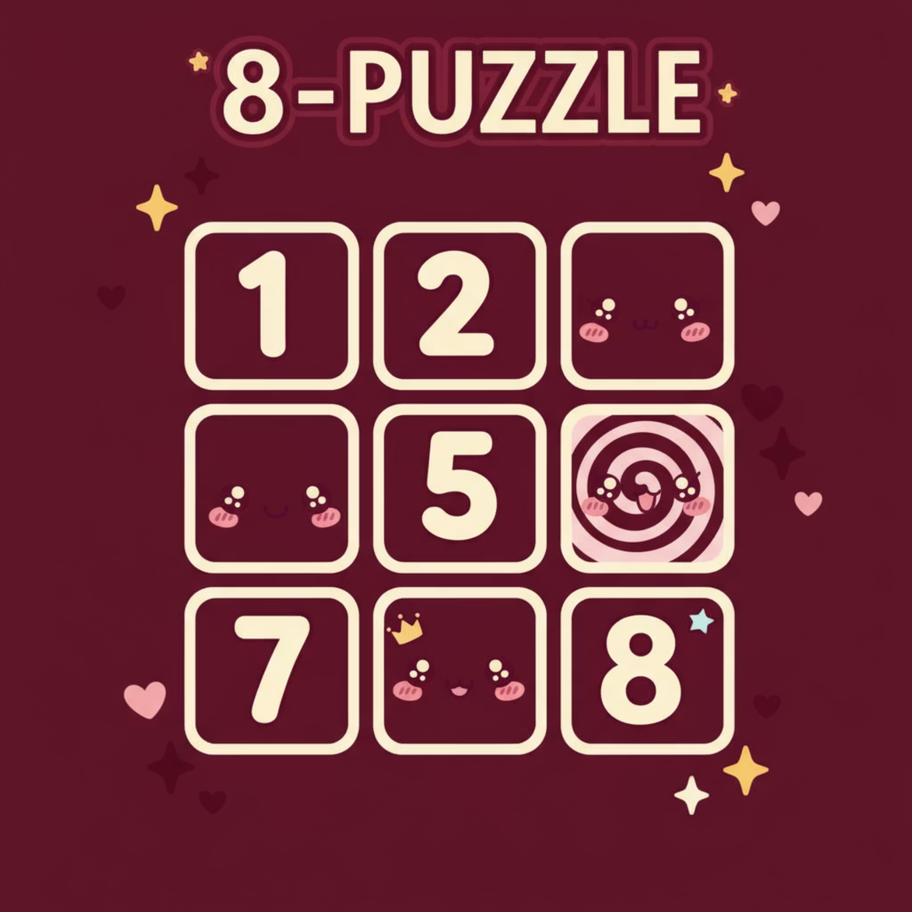
Uninformed and Informed Search Strategies
Search algorithms are fundamental to problem-solving in AI, exploring the state space to find a path from the initial state to a goal state.
State Space Search
Uninformed Search
Variations
The set of all possible states that a system can be in.
Breadth-First Search (BFS)
Depth-Limited Search (DLS)
Depth-First Search (DFS)
Iterative Deepening Search (IDS)
Bidirectional Search
8 Puzzle Problem
Components of a well-defined problem
A classic problem used to illustrate search algorithms, including both the normal (uninformed) and heuristic (informed) versions.
Initial State
The specific beginning configuration of the problem.
Actions
Operations that change the state from one to another.
Goal Test
A method to determine if a given state is the desired solution.
Path Cost
A numerical value associated with traversing a sequence of actions.

Slide 7
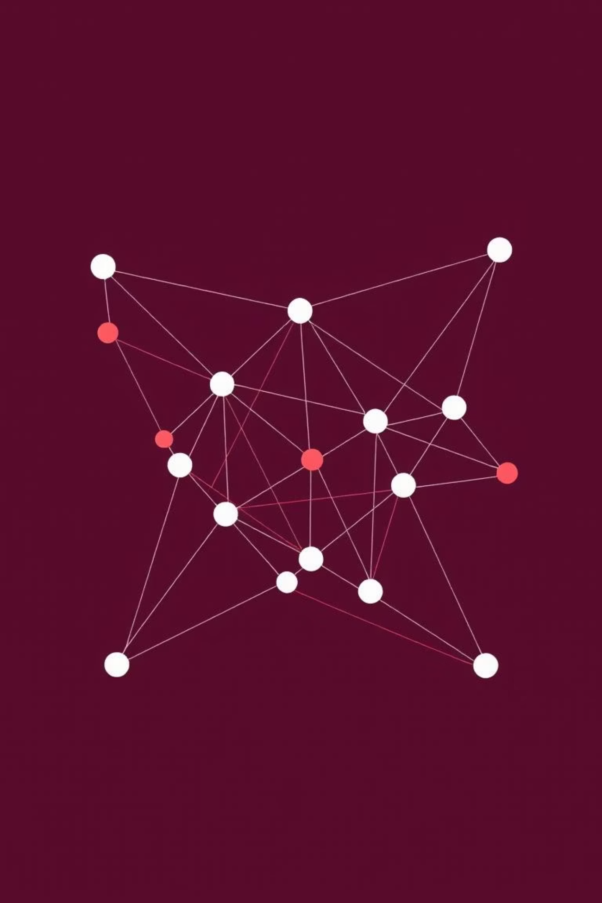
Heuristic Search and Performance
Heuristics in AI
1
Functions that estimate the cost from the current state to the goal state, guiding the search process.
Example: N-Queen Problem
Informed Search Algorithms
Best First Search
2
Beam Search
Hill Climbing
A* Search and A* Admissibility
AO* Algorithm
Measuring Performance
3
Evaluating problem-solving performance based on completeness, optimality, time complexity, and space complexity.

Slide 8

Constraint Satisfaction Problems (CSP)
CSPs are defined by a set of variables, a domain for each variable, and a set of constraints that specify allowable combinations of values.
Key CSP Concepts
Local Consistency and Heuristics
Map Coloring Graph: Assigning colors to regions such that no two adjacent regions have the same color.
Local Consistency (Constraint Propagation)
Types of Constraints: Unary, binary, and higher-order constraints.
Node, Arc, Path, K, and Global Consistency.
Cryptarithmetic Puzzle: Replacing letters with digits to make a valid arithmetic equation.
Bound Propagation
Used for constraints involving inequalities.
Backtracking
A general algorithm for finding solutions to CSPs.
MRV (Minimum Remaining Value)
Heuristic that chooses the variable with the fewest legal values remaining.
Degree Heuristic
Chooses the variable involved in the largest number of constraints on other unassigned variables.

Slide 9

Adversarial Search: Game Theory
Minimax Algorithm and Alpha-Beta Pruning
The Minimax algorithm is a decision rule used in game theory for minimizing the possible loss for a worst-case (maximum loss) scenario.
Alpha-Beta
Prune irrelevant branches
MIN Node
Alpha-Beta Pruning is an optimization technique for the Minimax algorithm that reduces the number of nodes evaluated in the search tree.
Select lowest value
MAX Node
Select highest value

Slide 10

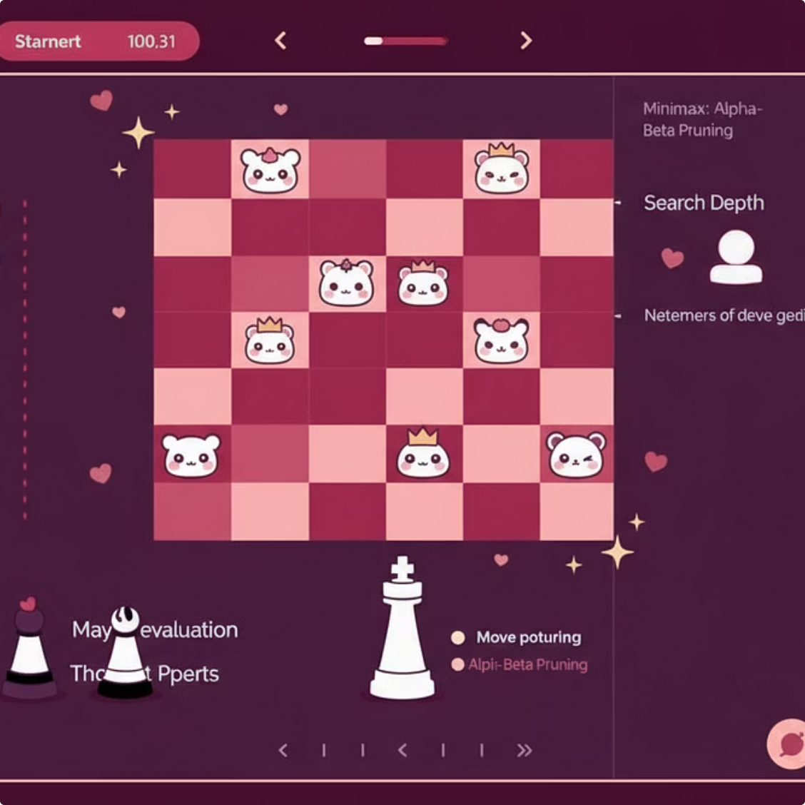
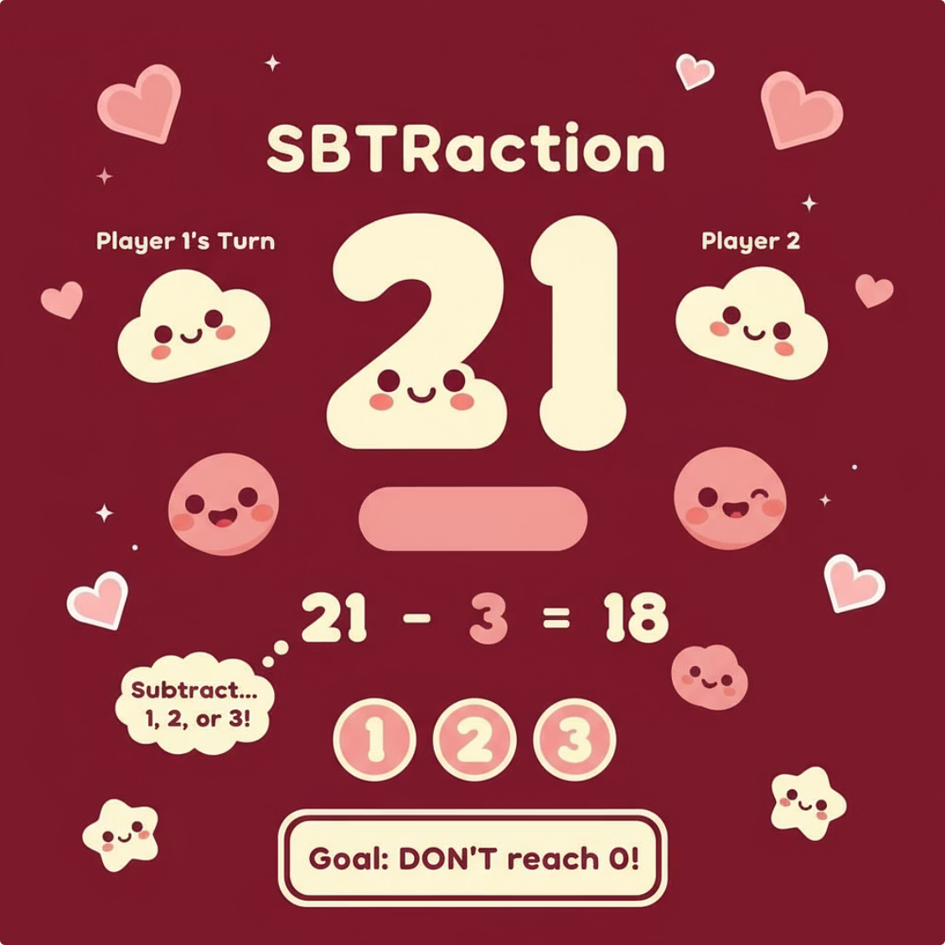
Lab Part:
Practical Application: AI Games
The lab component focused on implementing adversarial search algorithms to create functional game applications.
Tic Tac Toe Game
Chess Game
Subtraction Game
GUI version using Minimax Algorithm to ensure optimal play.
GUI version using Minimax and Alpha-Beta Pruning for efficient move calculation.
GUI version using Minimax Algorithm to determine the winning strategy.

Slide 11
Course Reflection / What I Learned
Deepened Understanding of AI
Problem-Solving Mastery
Adversarial Search Skills
Mastered the theoretical foundations, from agent types to environment characteristics.
Gained practical experience implementing search algorithms (BFS, DFS, A*) and CSP techniques.
Successfully applied Minimax and Alpha-Beta Pruning to develop functional game AIs.
Thank You!
Thank you for joining this AI journey! I hope you enjoyed exploring the fascinating world of artificial intelligence with me. 🌸

